Slide 1
Small Forwarding Table for Fast Routing Lookups
Author: Mikael Degermark, Andrej Brodnik, Svante Carlsson, Stephen Pink
Publisher: SIGCOMM ‘97
Presenter: Chun-Yu, Li
Date: 2016/07/13

Slide 2
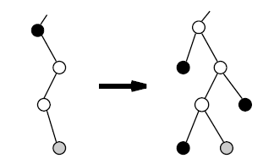
Introduction
Goal:
To minimize the number of memory accesses for a lookup operation and the size of the data structure.
Span the binary tree to be complete.
Each node has either two or no children.
Nodes with a child must be expanded to have two children.
Notes:
Leaf pushing: 把不是leaf的prefix node push到leaf上，prefix的資訊都會存在leaf node上
不影響search結果

Slide 3
Data Structure
The forwarding table is essentially tree with three levels.
Level 1 covers the prefix tree down to depth 16.
Level 2 covers depth from 17 to 24.
Level 3 covers depth from 25 to 32.

Slide 4
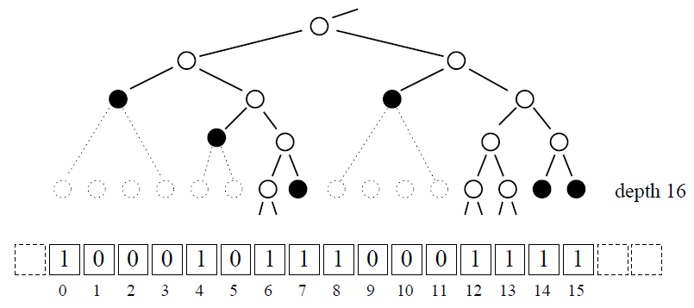
Data Structure
Cut through the tree at depth 16.
Represent each node by a bit-vector (total 2¹⁶=65536 bits).
Bit vector
(total 2¹⁶ bits)
one:
Root head: Prefix tree continues below the cut. (bits 6, 12, 13)
Genuine head: A leaf at depth 16 or less. (bits 0, 4, 7, 8, 14, 15)
zero:
A member of a range covered by a leaf at a depth less than 16.
(bits 1, 2, 3, 5, 9, 10, 11)
Notes:
有兩種情況我們會用bitmap的1來表示: Root head, Genuine head

Slide 5
Data Structure
Head information
Head information is encoded in 16-bit pointers stored in an array (pointer groups).
Genuine head
Store an index into the next-hop table.
Root head:
Store an index to the level two that represents the corresponding sub-tree.

Slide 6
Let a(n) be the number of possible non-zero bit-masks of length 2^{n}:
a(n) = 1 + a(n-1)²
2-bit case
Possible case
Impossible case
00、01
4-bit case
1 0 0 0
1 0 1 0
1 0 1 1
1 1 1 0
1 1 1 1 Total: 5 cases
Bit mask
1 0
1 1
Bit mask: 10、11
Notes:
Possibly

Slide 7
Let a(n) be the number of possible non-zero bit-masks of length 2^{n}:
a(n) = 1 + a(n-1)²
8-bit case
16-bit case
1 0 0 0 0 0 0 0
1 0 1 0 1 0 1 0
1 0 1 0 1 0 1 1
1 0 1 0 1 1 1 0
1 0 1 0 1 1 1 1
1 0 1 1 1 0 1 0
.
.
.
Bit mask
Total: 26 cases
1 0 0 0 0 0 0 0 0 0 0 0 0 0 0 0
1 0 1 0 1 0 1 0 1 0 1 0 1 0 1 0
1 0 1 0 1 0 1 0 1 0 1 0 1 0 1 1
1 0 1 0 1 0 1 0 1 0 1 0 1 1 1 0
.
.
.
Bit mask
Total: 677 cases

Slide 8
Data Structure
Find the pointer groups
Code word array & Base index array
${\text{2}}^{\text{16}}\text{/}{\text{2}}^{\text{4}}\text{=}{\text{2}}^{\text{12}}$=4096
Bit mask:
${\text{2}}^{\text{12}}\text{/}{\text{2}}^{\text{2}}\text{=}{\text{2}}^{\text{10}}$=1024
The code words contains a 10-bit value(r1, r2,…) and a 6-bit offset (0, 3, 10, …).
After four code words, the offset value might be too large to represent with 6-bit. Use a base index be the offset to find a group of pointers. ( Length of base index array element is 16 bits. )

Slide 9
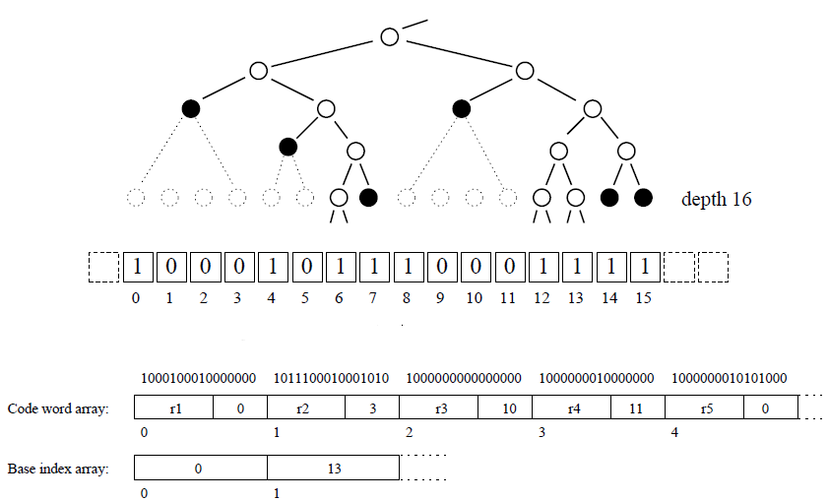
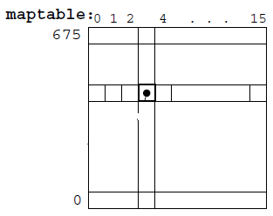
Data structure
Maptable

Slide 10
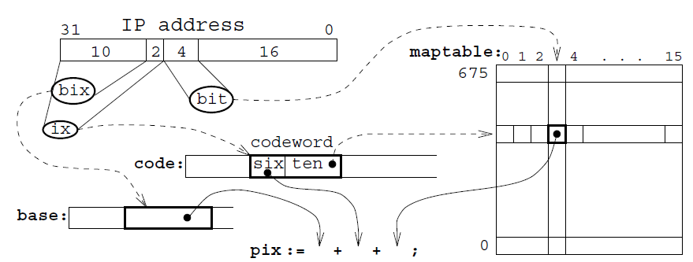
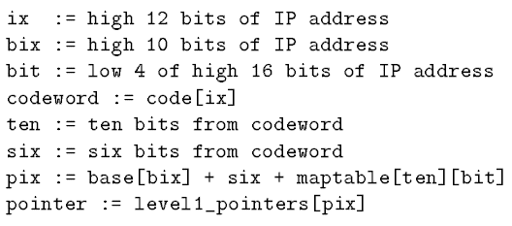
Search
Search the first level of the data structure.
To find the correct pointer in the group of pointers.
Steps to search 1st level:

Slide 11
Level 2 & 3
Levels two and three consist of chunks.
Chunks: covers a sub-tree of height 8 and can contain at most 2⁸=256 heads.
1-8 heads: chunk is “sparse”
array of 8-bit indices of the heads
9-64 heads: chunk is “dense”
just one base index for all 16 codewords
65-256 heads: chunk is “very dense”
chunks are searched analogously with the 1st level.

